Slide 1

ROCKBUSTER STEALTH LLT ONLINE VIDEO LAUNCH STRATEGY
MILICA KIKOVIC January 2024

Slide 2

Rockbuster Stealth LLC, which used to have movie rental stores worldwide, has decided to leverage its existing movie licenses to launch its own online video rental service. This move has been necessitated by the need to stay competitive in the age of streaming services like Netflix and Amazon Prime.

Slide 3

KEY QUESTIONS AND OBJECTIVES
Which movies contributed the most/least to revenue gain?
What was the average rental duration for all videos?
Which countries are Rockbuster customers based in?
Where are customers with a high lifetime value based?
Do sales figures vary between geographic regions?

Slide 4






Total Revenue 61,312 $
Films in Library 1000
DATA OVERVIEW
# of film Genres 16
Countries with Customers 109
Cities with Customers 597
Total Customers 599

Slide 5
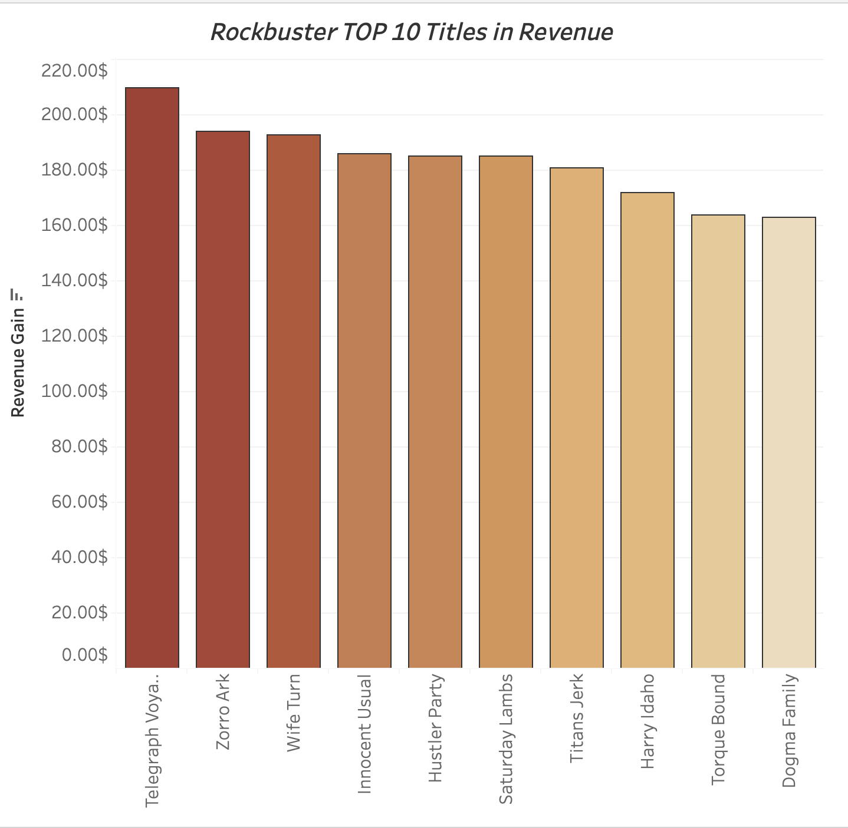
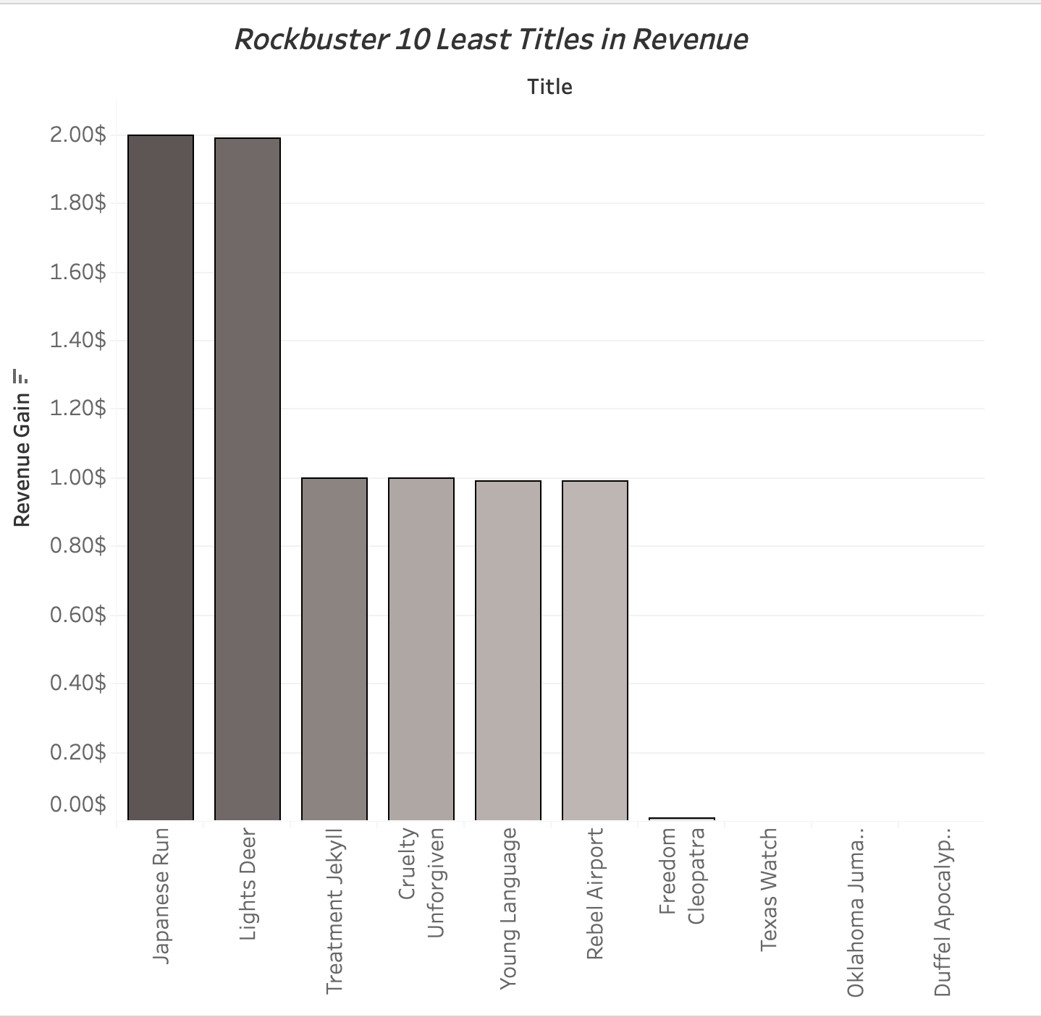
Which movies contributed the most/least to revenue?

Slide 6
What was the average rental duration for all videos?
 | MIN | MAX | AVG
Rental Rate | $ 0.99 | $4.99 | $2.98
Rental Duration | 3 Days | 7 Days | 5 Days
Replacement Cost | $9.99 | $29.99 | $19.98
Movie Length | 46 Min | 185 Min | 115 Min

Slide 7
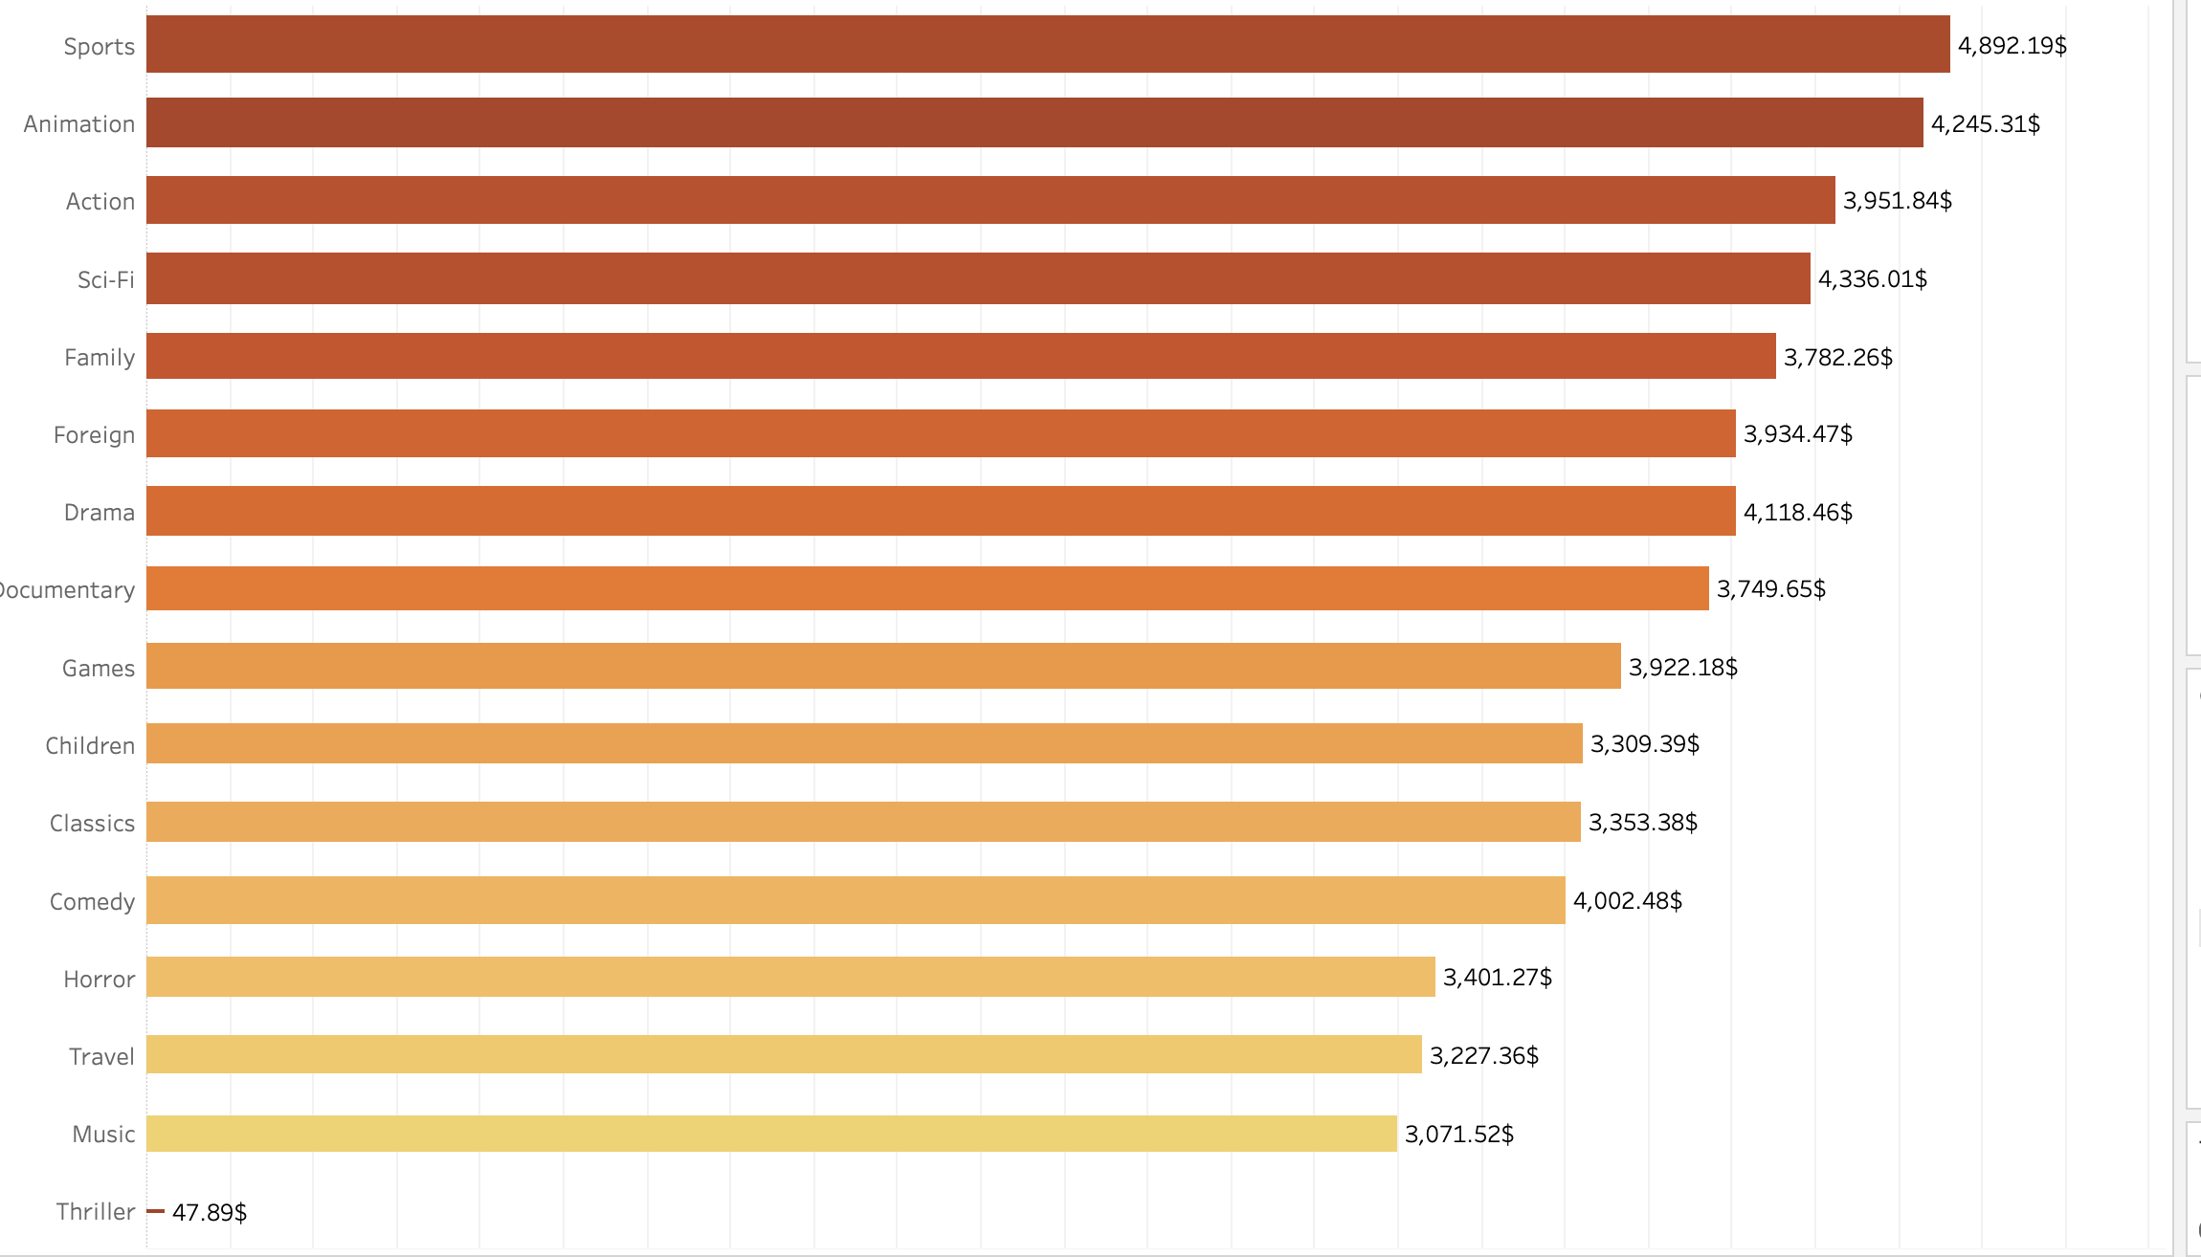
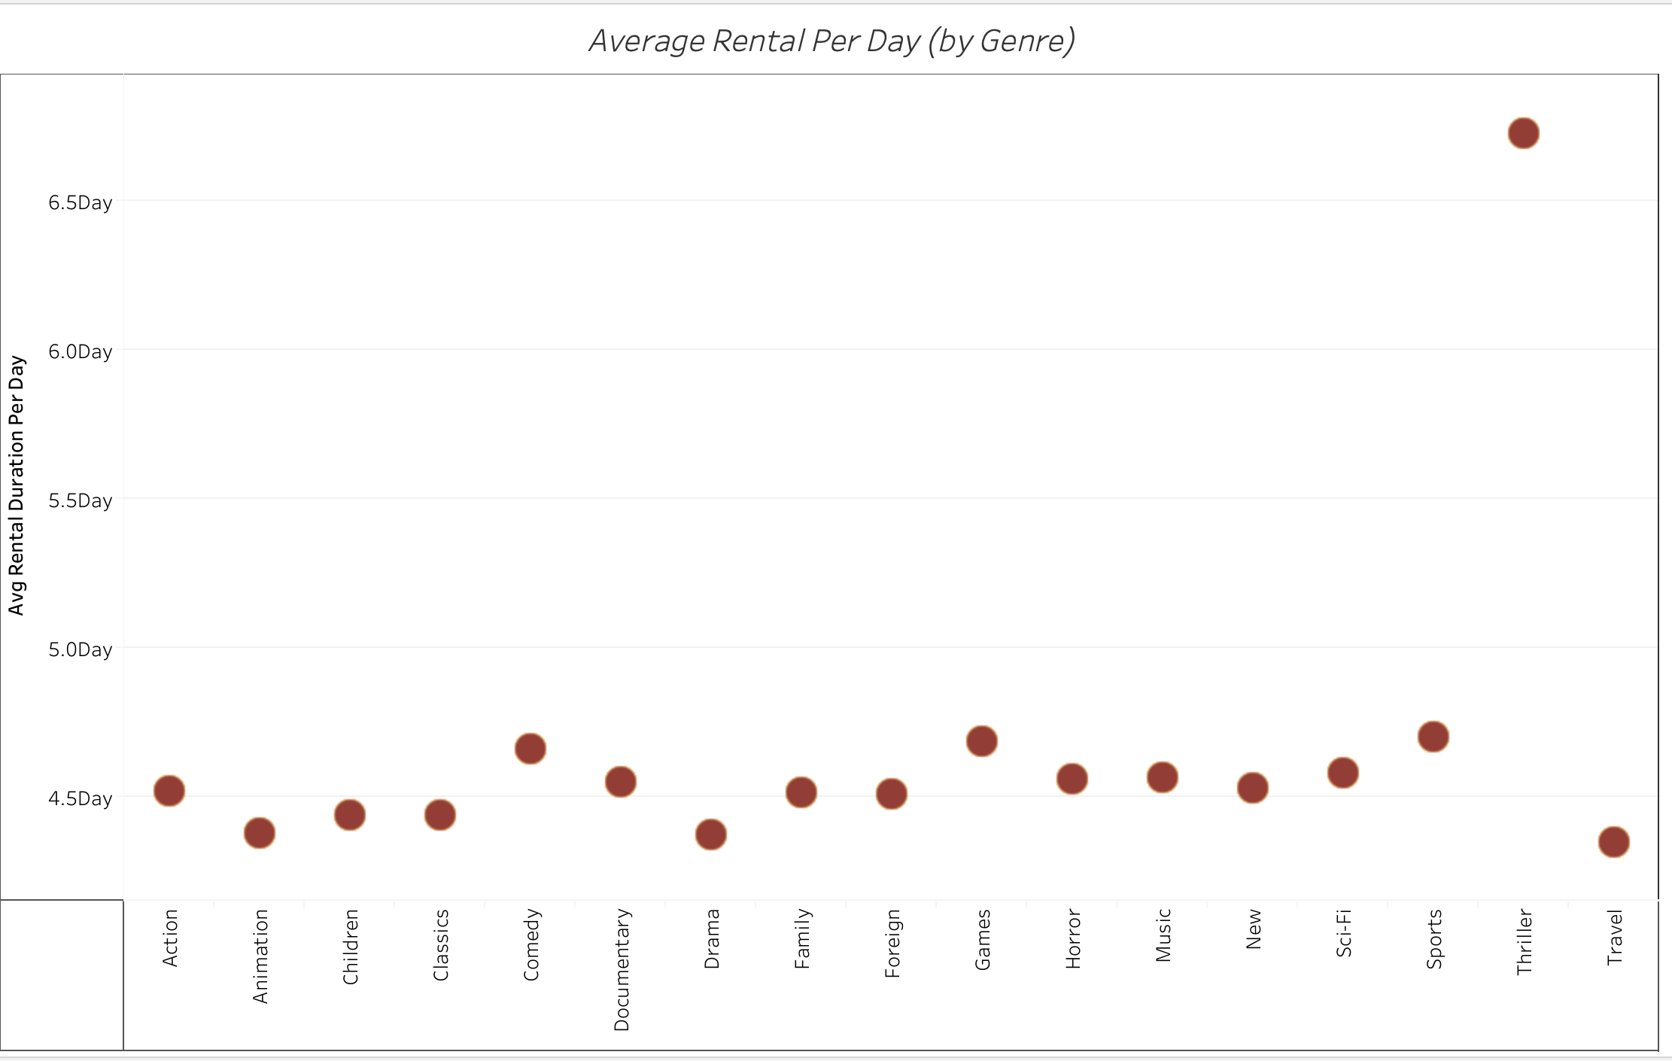
Revenue by Movie Genre

Slide 8
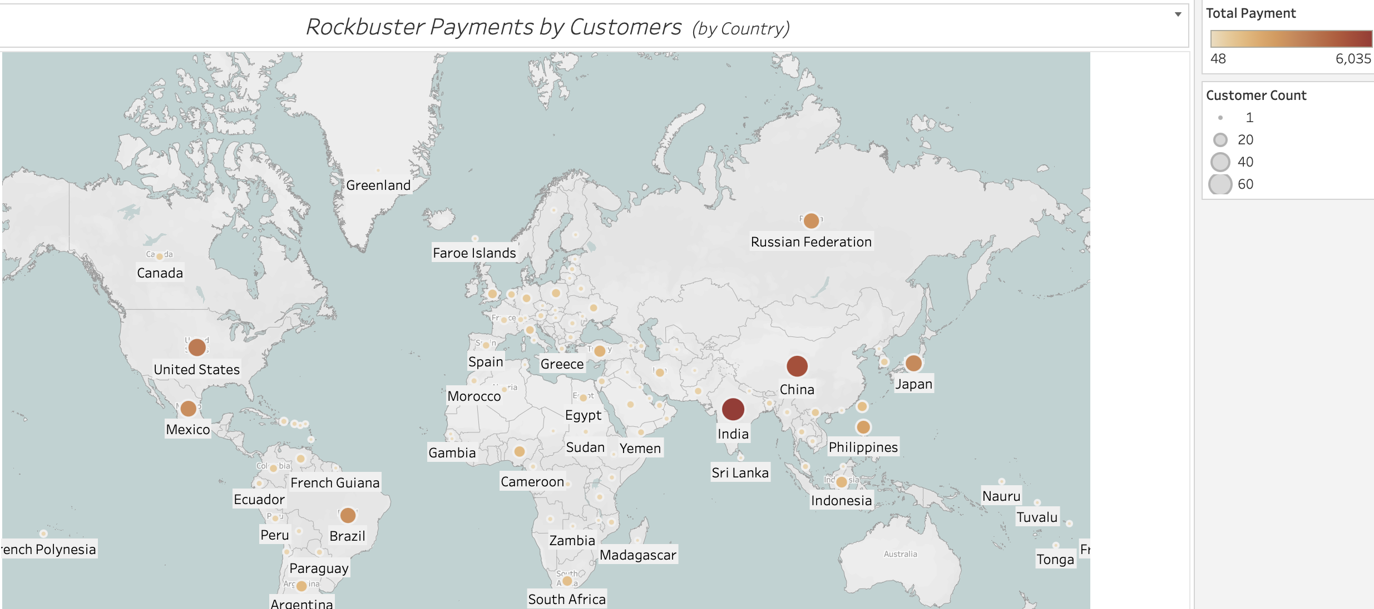
Which countries are Rockbuster customers based in? Do sales figures vary between geographic regions?

Slide 9
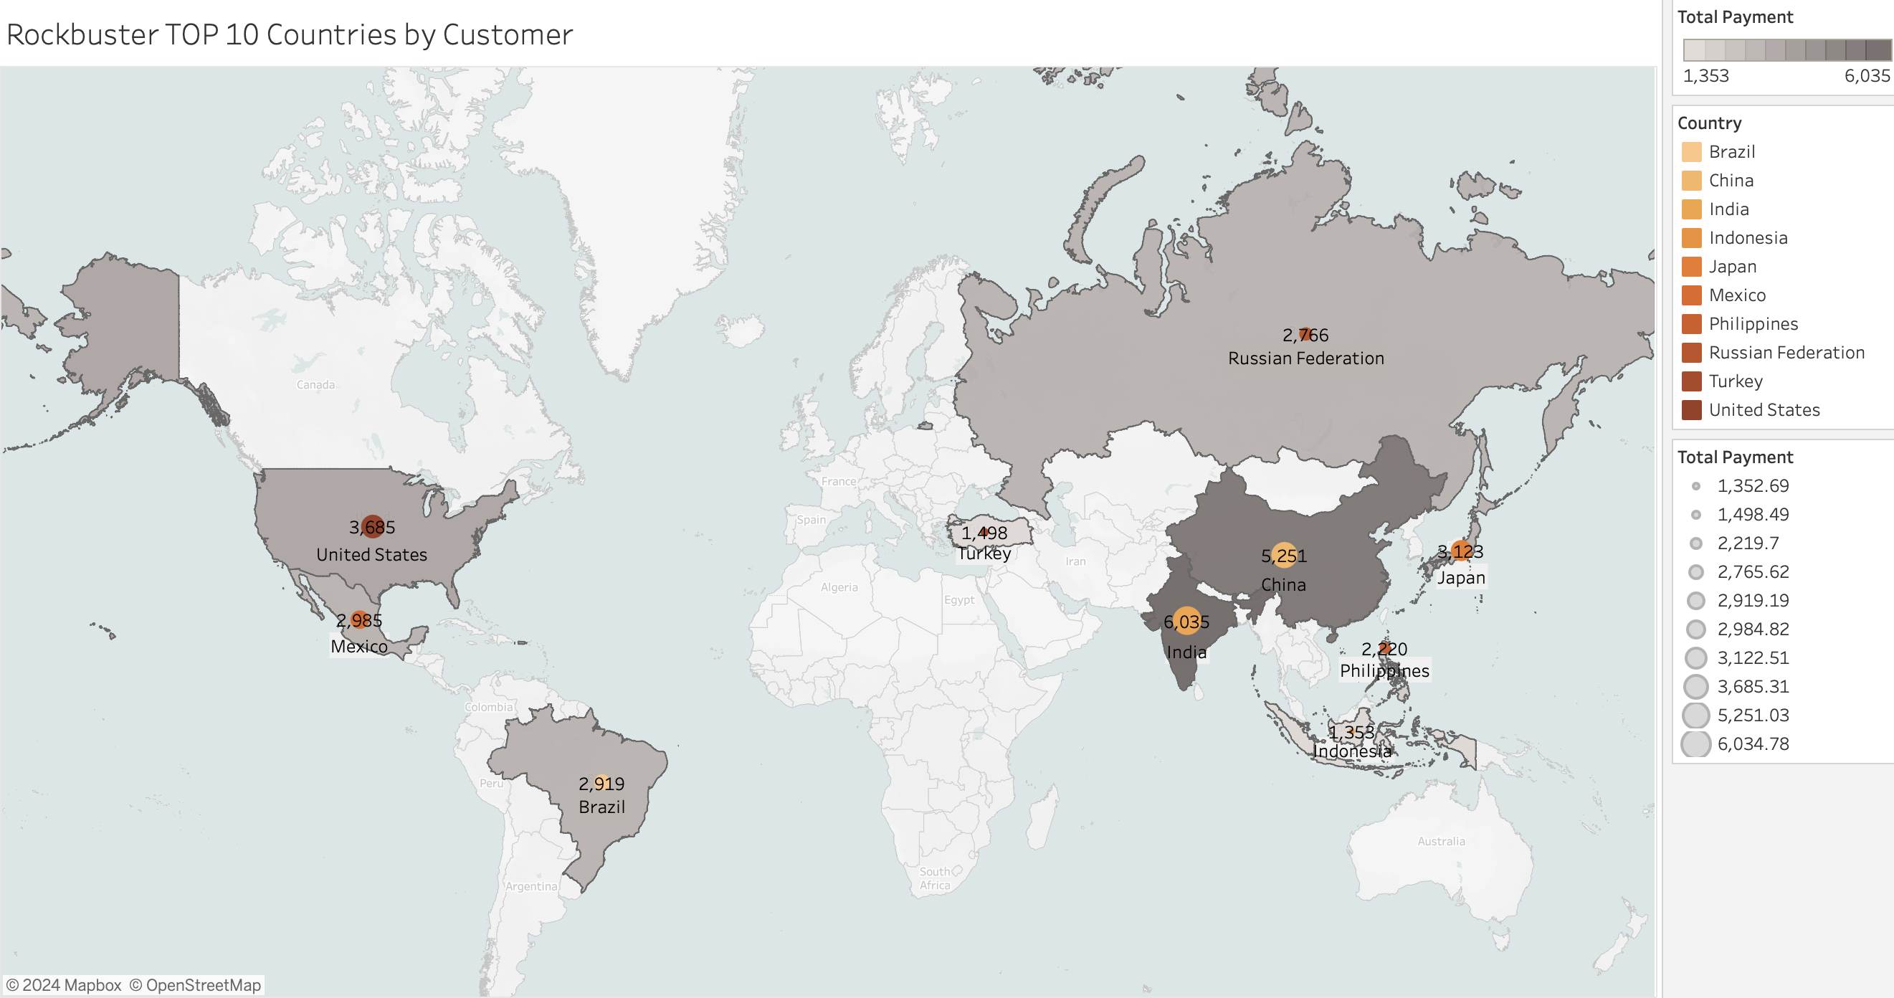
Where are customers with high lifetime value based?

Slide 10

Conclusion and Recommendations
The number of Rockbuster customers varies significantly by country, with India having the highest number of customers 60
We have customers in numerous countries worldwide, with over half of them residing in Asia and the Americas. The US, India, The Philippines, Brazil, Mexico, and Russia are the countries with customers having the highest lifetime value.
The top five film genres by revenue are Sports, Sci-Fi, Animation, Drama, and Comedy, accounting for 35%. The bottom five genres, which include Horror, Classics, Children, Travel, and Music, account for only 26%.
The average rental duration if 4.99 days. For the first 3 months after the launch I would offer a special discount or a free coupon if someone rents an online video for a minimum of 5 days.
To launch the online video rental service, it is recommended to target the six best-performing countries, which are India, China, the the online video rental service, it is recommended to target the six best-performing countries, which are India, China, United States, Japan, Mexico, and Brazil. It's important to note that three of these countries have four out of the top ten customers with high lifetime value.

Slide 11



Questions?
Milica Kikovic
Data Analyses \ Data Immersion SQL
https://public.tableau.com/app/profile/milica.kikovic/viz/ROCKBUSTERPRESENTATIONKikovic/Sheet9

